Slide 1
ONLINE HARWARE AND SOFTWARE SUPPORT SYSTEM
PRESENTED BY:
RAJA NANTHINI K
SANKARA GOMATHI A
SIVA PRIYA A
HARIN JEEVA S

Slide 2
OBJECTIVE
Nowadays every organization uses lots of IT based hardware and software to do their business. These include PC, printer, scanner ,some applications (IDE)etc .
Employees of the organization uses these hardware and software for their daily work.
If by some reason, these hardware goes down, daily productivity of the concerned employee gets affected.
So it is very important to take care of these hardware and software and in case of fault , that should be repaired in priority basis .

Slide 3
ABSTRACT
SYSTEM ENGINEERS DEPARTMENT or SED has one HOD(Head Of the Department) and many engineers.
Engineers reports to HOD. Whenever any complain is lodged , complain is written in complain register , then that work is assigned(by HOD) to a engineer , who is relatively free.
Engineers goes to corresponding employees desk and fixes the problem and updates the complain register

Slide 4
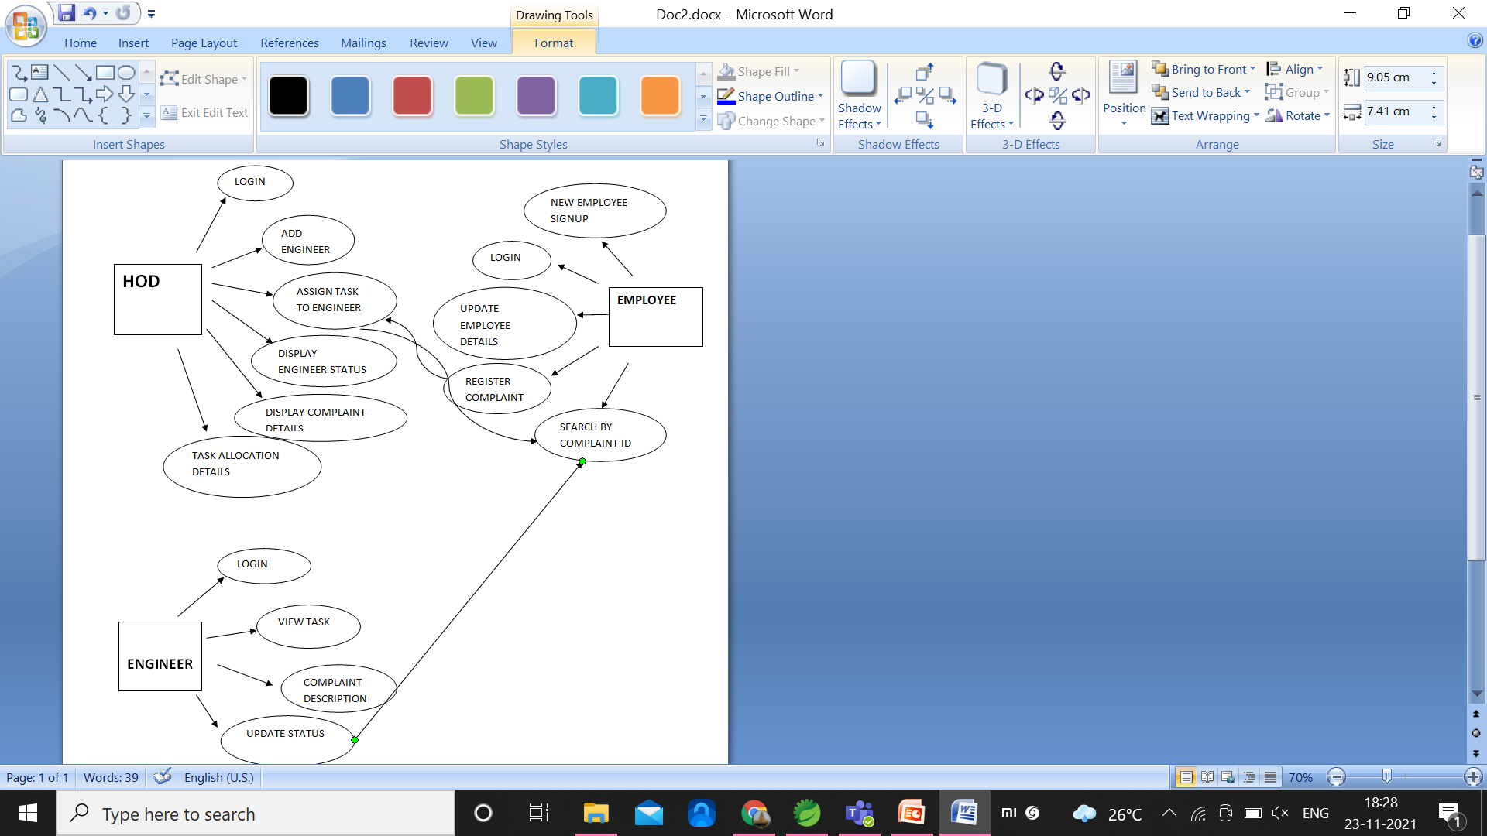
USECASE

Slide 5
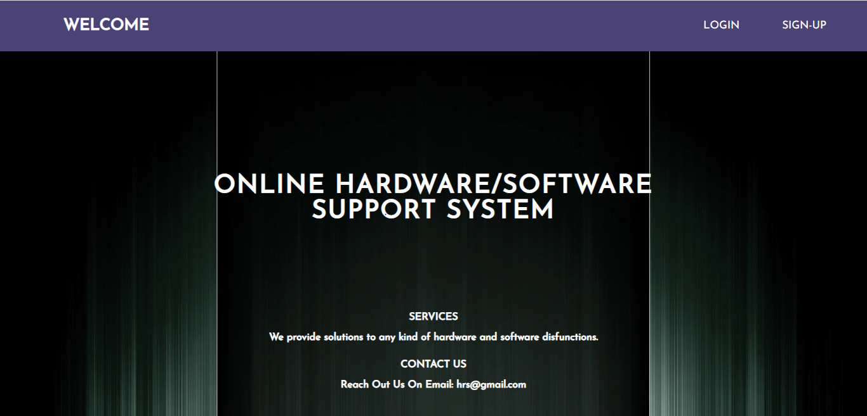
HOME PAGE

Slide 6
LOGIN/SIGNUP
One Login page possess 3 kind of login for HOD, Engineer and Employee as well.
If employee is new to this portal he have to register himself/herself first using signup form provided specifically for new employees.
Each user have to login using their username and password and have to select their domain as HOD/Engineer/Employee

Slide 7
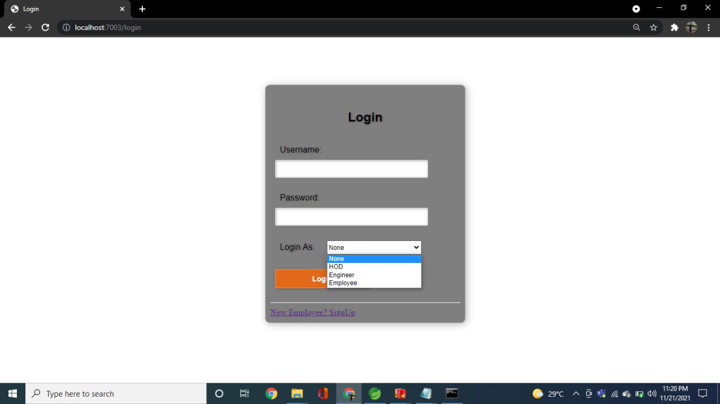
SCREENSHOT

Slide 8
EMPLOYEE PORTAL
If the employee has some complaint ,he can raise complaint using his/her portal for existing user.
When the employee logs in to this portal he/she can be able access:
Update Employee
Register a Complaint
View status of complaint.
Main access is through this portal he/she can raise a complaint for their dysfunction.

Slide 9
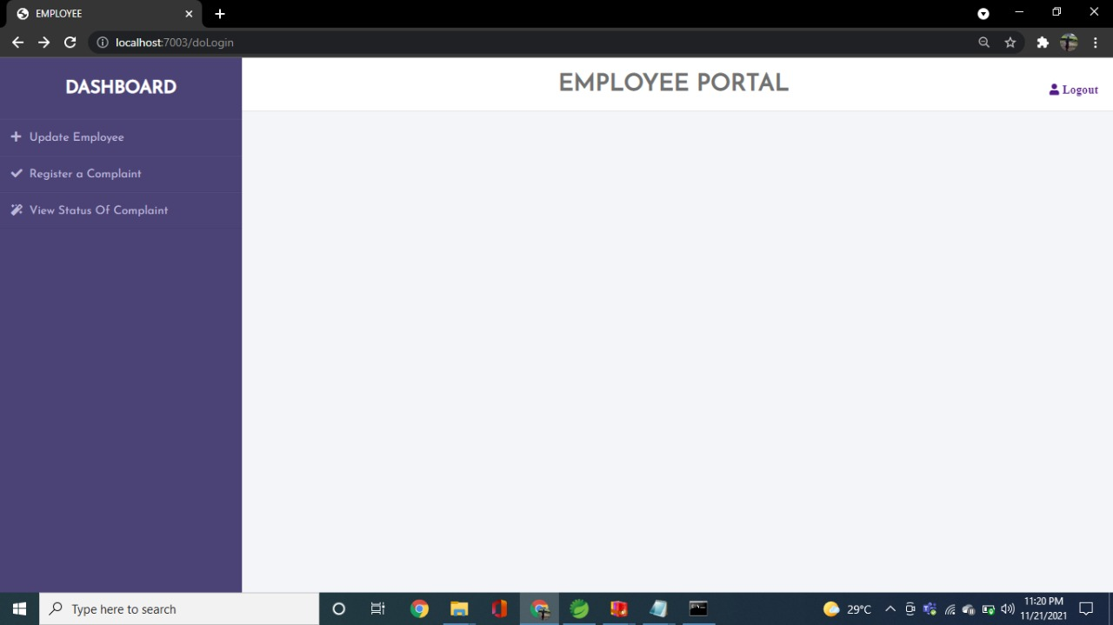
SCREENSHOT

Slide 10
HOD PORTAL
If the employee has some complaint ,HOD can assign complaint using his/her portal to existing engineer.
When the HOD logs in to this portal he/she can be able access:
Add Engineer
Assign task
Display engineer status
Display complaint details
Complaint allocation details
Main access is through this portal he/she can assign a complaint for their dysfunction.

Slide 11
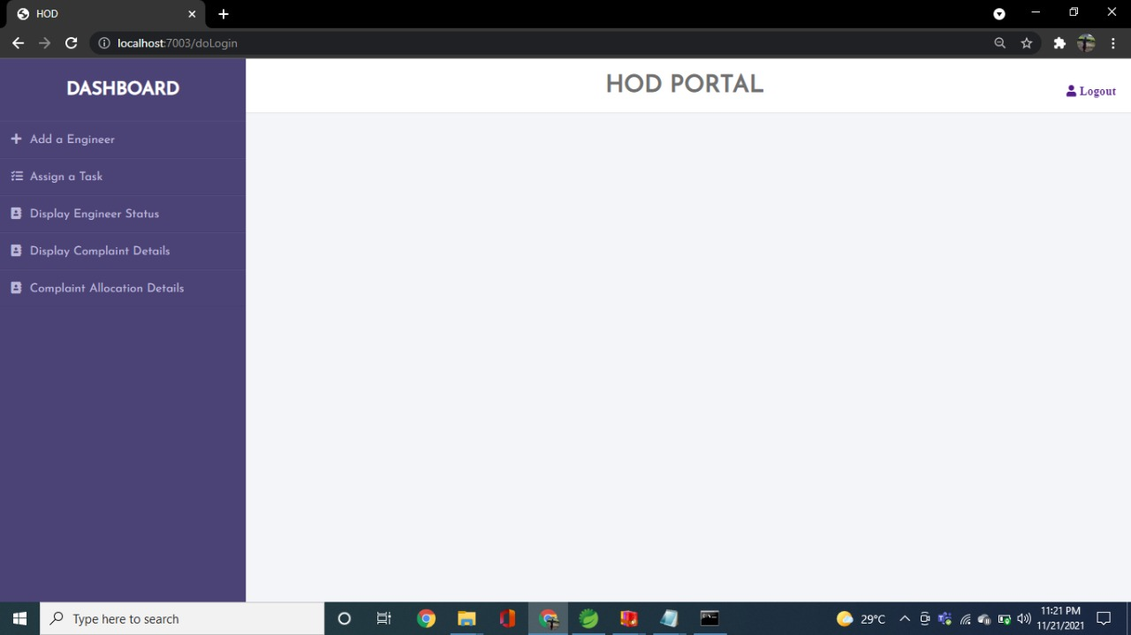
SCREENSHOT

Slide 12
ASSIGN TASK
In Assign task module, the complaint details registered by the employee can be viewed in this module.
Based on the complaint the HOD can assign task to the engineer.
After assigning engineer, the engineer status and complaint status will be automatically updated.
The entire task allocation details can be viewed by HOD.

Slide 13
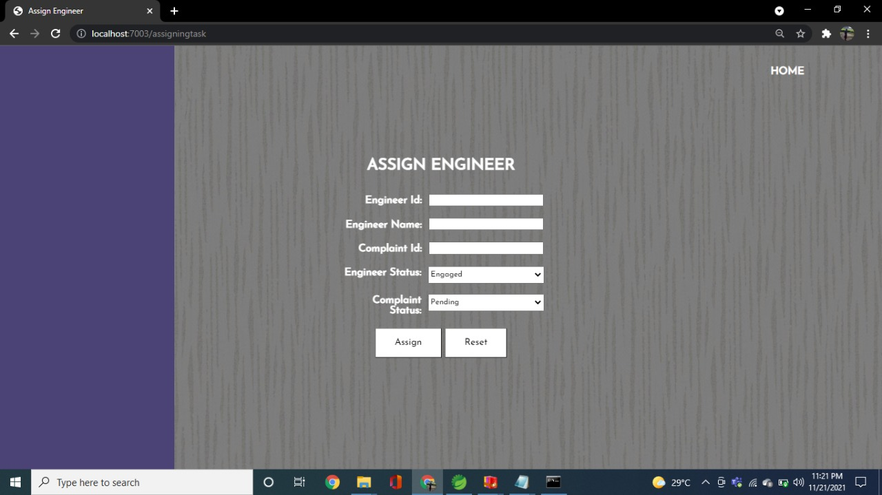
SCREENSHOT

Slide 14
ENGINEER PORTAL
If the engineer has some complaint assigned by HOD.
The Engineer can solve the complaint and update the status of the complaint using his/her portal for existing user.
When the engineer logs in to this portal he/she can be able access:
View task
Complaint Description
Update status
Main access is through this portal engineer can solve the complaint for the employee dysfunction.

Slide 15
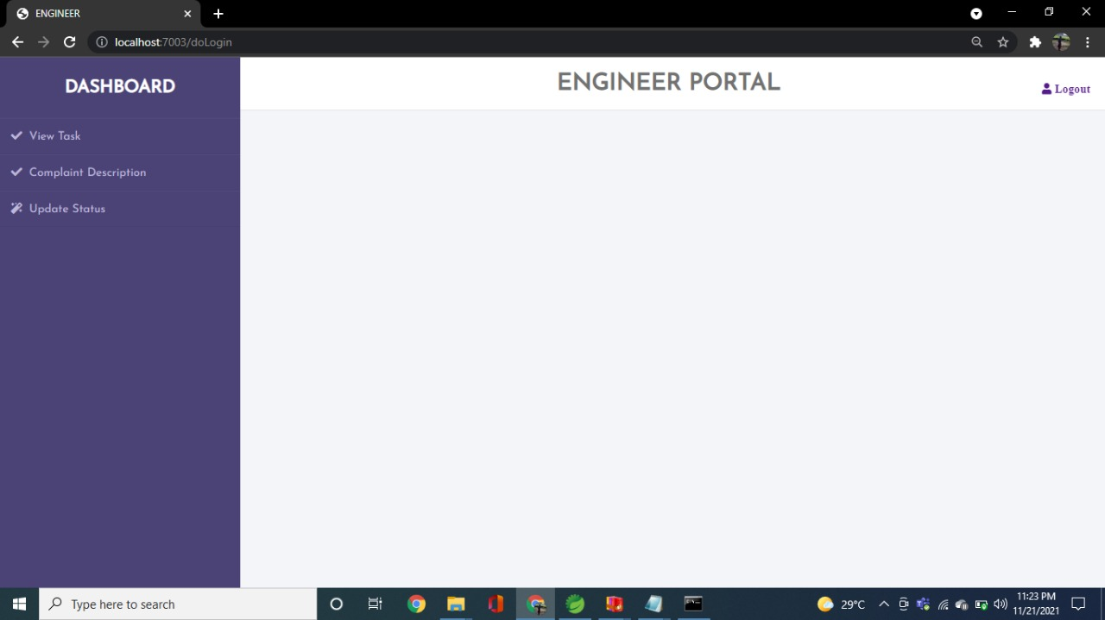
SCREENSHOT

Slide 16
ENGINEER TASK STATUS
Engineer task status module is used to track the status of the complaint assigned to one particular engineer.
Using this we can also able to get the solution for the complaint for which the engineer has raised.
In this we have retrieved status using the following details:
Employee Id, Employee Name, complaint Id, Solution, Engineer status whether they they’re available-already allocated, lastly the complaint status whether it is solved-unsolved-pending.

Slide 17
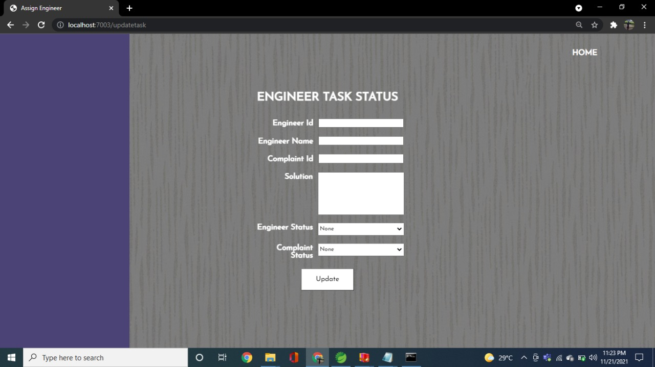
SCREENSHOT

Slide 18
SEARCH BY COMPLAINT ID
Using the field search by complaint ID, we can able to retrieve all the details of the specific complaint that has been raised by the employee.
Details that can be retrieved are as follows:
Complaint Id
Solution
Complaint Status
Using Home button we can return back to the portal page again.

Slide 19
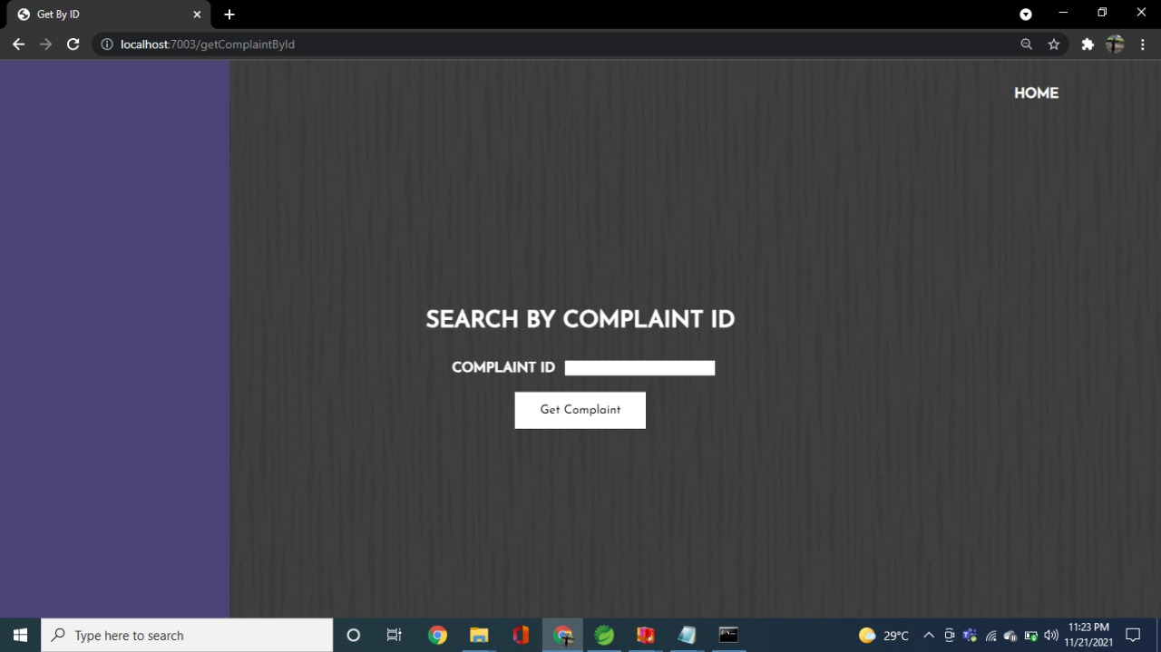
SCREENSHOT

Slide 20
HOD PORTAL
After the solution is provided by engineer,
Display engineer status
Display complaint status
Complaint allocation details
Can be viewed by HOD.
Based the engineer and complaint status, the HOD can assign a task for further complaints.

Slide 21
SCREENSHOT

Slide 22
FUTURE SCOPE
Using history, we will update the portal so that the engineer, employee can be able to view his/her whole complaint details so far they’ve done with this online portal.
In engineer portal, soon we will add notification criteria for viewing his tasks which will be very much helpful for that engineer to complete his/her tasks once assigned.
Retrieving using unique ID will be extended to every portal for easy and tireless process.

Slide 23
THANK YOU

